Slide 1
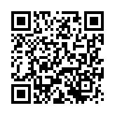
2024
August
This certificate is Proudly Presented to
Azatova Guliston Norimonovna
For Publication of the Manuscript Entitled
Volume 14,Issue 08
SOME REMARKS ON THE LEXICON OF KHORAZM FOLK SAYINGS
Journal of Applied Science and Social Science eISSN: 2229-3213 pISSN: 2229-3205
Impact factor: 2019: 4.679 2020: 5.015 2021: 5.436, 2022: 5.242, 2023: 6.995, 2024 7.75
25.08.2024

